Slide 1
Entity-Centric Topic-Oriented Opinion Summarization in Twitter
Date : 2013/09/03
Author : Xinfan Meng, Furu Wei, Xiaohua, Liu, Ming Zhou,
Sujian Li and Houfeng Wang
Source : KDD’12
Advisor : Jia-ling Koh
Speaker : Yi-hsuan Yeh

Slide 2
Outline
Introduction
Topic Extraction
Opinion Summarization
Experiment
Conclusion

Slide 3
Introduction
Microblogging services, such as Twitter, have become popular channels for people.
People not only share their daily update information or personal conversation, but also exchange their opinions towards a broad range of topics.
However, people may express opinions towards different aspects, or topics, of an entity.

Slide 4
Introduction
Goal :
Produce opinion summaries in accordance with topics and remarkably emphasizing the insight behind the opinions.

Slide 5
Outline
Introduction
Topic Extraction
Opinion Summarization
Experiment
Conclusion

Slide 6
Topic Extraction
#hashtags
They are created organically by Twitter users as a way to categorize messages and to highlight topics
We use #hashtags as candidate topics.
Notes:
highlight 強調

Slide 7
Topic Extraction
Collect a dictionary from ODP, Freebase
Rule-base classifier
Split #hashtags into multiple words and then check if some of words in person/location dictionary
Tagness (threshold=0.85)
ex : occurrences of #fb = 95, total occurrences of its content = 100
tagness = 95/100 = 0.95 > 0.85 (remove)

Slide 8
Graph-based Topic Extraction
Affinity Propagation algorithm
Input : #hashtags pairwise relatedness matrix
output : #hashtags clusters and the centroids of clusters.
Co-occurrences Relation
h1
h2
h1
h2
h5
h5
h3
h3
h6
h6
h4
h4

Slide 9
Relatedness
Context Similarity
ex : hi hj
t1
t2
t3
t4
Cosine(h_{i}, h_{j}) =
[(4*2)+(0*3)+(5*0)+(3*6)] /
[(4²+5²+3²)^{1/2} ]*[(2²+3²+6²)^{1/2}]
4
0
5
3
2
3
0
6

Slide 10
Relatedness
Topic-Aware Distributional Similarity
Labeled LDA
ex : h_{i} h_{j}
w₁
w₂
w₃
w₄
KL(h_{i}, h_{j}) =
( ln (0.4/0.3) * 0.4)+
( ln (0.3/0.1) * 0.3)+
( ln (0.1/0.5) * 0.1)+
( ln (0.2/0.1) * 0.2)
0.4
0.3
0.1
0.2
0.3
0.1
0.5
0.1
Other words in the tweets

Slide 11
Topic Labeling and Assignment
For a tweet with #hashtag(s), we assign it the topic(s) corresponding to every #hashtag in the tweet
For a tweet without #hashtags, we predict its topic using a SVM classifier
Bag-of-words feature

Slide 12
Outline
Introduction
Topic Extraction
Opinion Summarization
Insightful Tweet Classification
Opinionated Tweet Classification
Summary Generation
Experiment
Conclusion

Slide 13
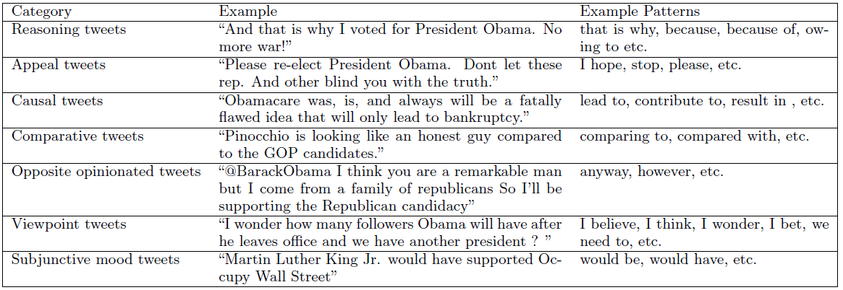
Insightful Tweet Classification
Standford Parser
match the pattern syntax trees against the tweet syntax trees
To create a high coverage pattern set, we use a paraphrase generation algorithm
ex : “that is why” → “which is why”

Slide 14
Opinionated Tweet Classification
A lexicon-based sentiment classifier relies on sentiment dictionary matching
counts the occurrences of the positive (cp) and negative (cn) words
Negation expressions
the distance in words between neg and w is smaller than a predefined threshold (5) → invert the sentiment orientation
ex : “eliminate”, “reduce”

Slide 15
Target-lexicon dependency classification
A binary SVM classifier to determine whether the sentiment word (w) is used to depict the target (e).
Feature:
The distance in word between w and e
Whether there are other entities between w and e
Whether there are punctuation(s) between w and e
Whether there are other sentiment word(s) between w and e
The relative position of w and e : w is before or after e
Whether these is a dependency relation between w and e (MST Parser)

Slide 16
Summary Generation
Selecting a subset of tweets P from tweet set Tk for topic k
Language style score
ex : “I am Avril Lavigne’s biggest fan!! ❤”
L(t_{i}) = 1+ (1/7) = 1.143

Slide 17
Topic relevance score
Term distribution of tweet ti and topic label lk
ex : t_{i} l_{k}
t₁
t₂
t₃
t₄
KL(t_{i},l_{k}) =
( ln (0.1/0.2) * 0.1)+
( ln (0.5/0.1) * 0.5)+
( ln (0.2/0.6) * 0.2)+
( ln (0.2/0.1) * 0.2)
0.1
0.5
0.2
0.2
0.2
0.1
0.6
0.1

Slide 18
Redundancy score
Word distribution of tweet t_{i} and tweet t_{j}
ex : t_{i} t_{j}
t₁
t₂
t₃
t₄
t₅
KL(t_{i},l_{k}) =
( ln (0.4/0.1) * 0.4)+
( ln (0.1/0.35) * 0.1)+
( ln (0.15/0.2) * 0.15)+
( ln (0.3/0.15) * 0.3)+
( ln (0.05/0.2) * 0.05)+
0.4
0.1
0.15
0.3
0.05
0.1
0.35
0.2
0.15
0.2

Slide 19
Outline
Introduction
Topic Extraction
Opinion Summarization
Experiment
Conclusion

Slide 20
Data
2011.9 ~ 2011.10

Slide 21
Evaluation of Topic Extraction

Slide 22
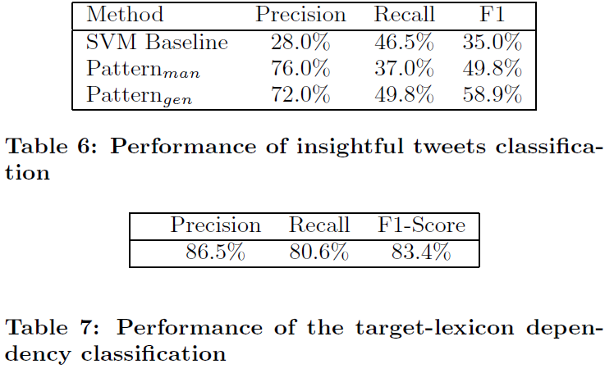
Evaluation of Opinion Summarization

Slide 23
Language style score = 1

Slide 24
Outline
Introduction
Topic Extraction
Opinion Summarization
Experiment
Conclusion

Slide 25
Conclusion
An entity-centric topic-oriented opinion summarization framework, which is capable of producing opinion summaries in accordance with topics and remarkably emphasizing the insight behind the opinions in Twitter.
In the future, we will further study the semantics underlying #hashtags, which we can make use of to extract more comprehensive and interesting topics.

